Slide 1
IT306
Module 8
Heap,TreeSet

Slide 2
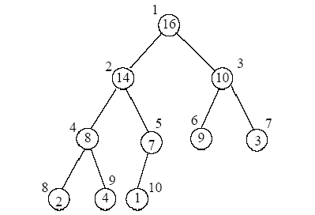
Recap: Traversal
A traversal is a process that visits all the nodes in the tree.
Depth-first Traversal
In-Order (Symmetric) left-root-right
Pre-Order root-left-right
Post-Order left-right-root
In-order:
2,8,4,14,1,7,16,9,10,3
Pre-order:
16,14,8,2,4,7,1,10,9,3
Post-order
2,4,8,1,7,14,9,3,10,16

Slide 3
Recap: BST (Binary Search Tree): Insert
Use a data structure that stores elements after inserting the following keys (from left to right). The data structure is initially empty. Always start from the root. The left child key value is always <= parent, and the right child key value is > parent.
Key= {17, 9 , 26 , 12, 11 ,7,30,20,21,10}
Every element in n’s left subtree is less than or equal to the element in node n.
Every element in n’s right subtree is greater than the element in node n.

Slide 4
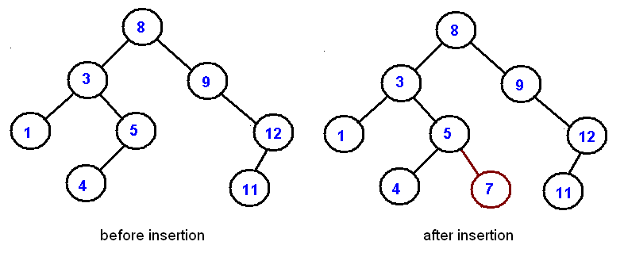
Recap: Insertion
Insert 7

Slide 5
Recap: Insertion
Draw a binary search tree by inserting the below numbers from left to right:
11, 6, 8, 19, 4, 10, 5, 17, 43, 49, 31
11
6
19
4
8
17
43
5
10
31
49

Slide 6
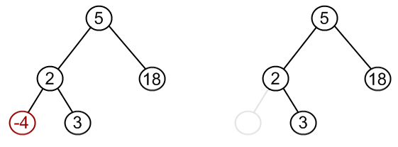
Recap: Delete
Node to be removed has no children:
Remove -4 from a BST.

Slide 7
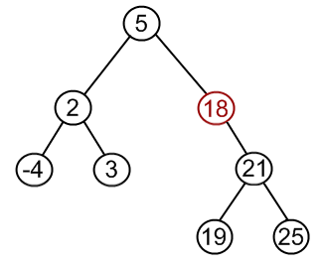
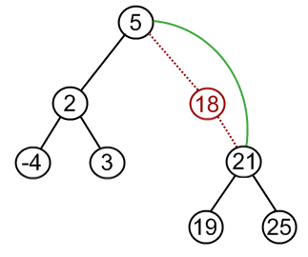
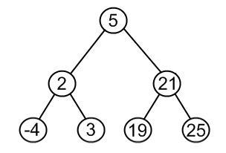
Recap: Delete
Node to be removed has one child.
Remove 18 from a BST.

Slide 8
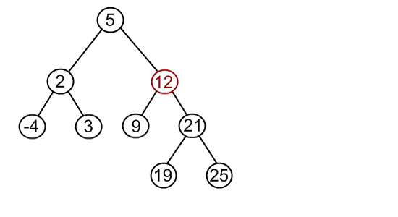
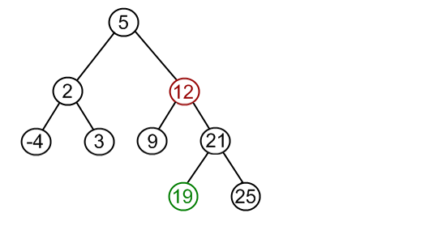
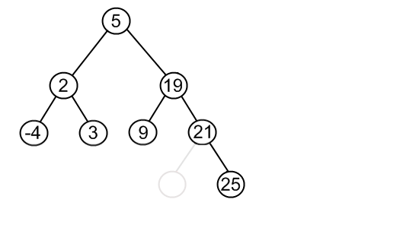
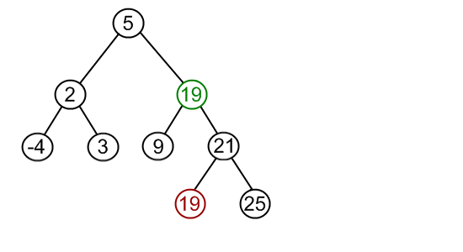
Recap: Delete
Node to be removed has two children (the most complex one).
Algorithm:
Find the minimum node in the right sub tree of the node that must be removed.
Replace that minimum node with the node to be removed.
Remove the node duplicate from its prior location.

Slide 9
Recap: Sequence-based Priority Queue
Implementation with an unsorted list
Performance:
insert takes O(1) time since we can insert the item at the beginning or end of the sequence.
removeMin and min take O(n) time since we have to traverse the entire sequence to find the smallest key.
Implementation with a sorted list
Performance:
insert takes O(n) time since we have to find the place where to insert the item
removeMin and min take O(1) time, since the smallest key is at the beginning
4
5
2
3
1
1
2
3
4
5
© 2010 Goodrich, Tamassia

Slide 10
Recap: Sorted vs. Unsorted PQ (insert, min, removemin, size , isempty)
9,A
8,B
6,Q
2,N
1,H
Sorted PQ , n = 5
1,H
8,B
9,A
6,Q
2,N
UnSorted PQ, n=5

Slide 11
Heap , TreeSet

Slide 12
Heaps
A heap is a binary tree storing keys at its nodes and satisfying the following properties:
Heap-Order: for every internal node v other than the root, key(v) ≥ key(parent(v))
Complete Binary Tree: let h be the height of the heap
for i = 0, … , h - 1, there are 2^{i} nodes of depth i
at depth h - 1, the internal nodes are to the left of the external nodes.
The last node of a heap is the rightmost node of maximum depth.
2
5
6
9
7
last node
© 2010 Goodrich, Tamassia
Notes:
Complete binary tree: if all levels except possibly the last are completely full, and the last level has all its nodes to the left.

Slide 13
Height of a Heap
Theorem: A heap storing n keys has height O(log n)
Proof: (we apply the complete binary tree property)
Let h be the height of a heap storing n keys
Since there are 2^{i} keys at depth i = 0, … , h - 1 and at least one key at depth h, we have n ≥ 1 + 2 + 4 + … + 2^{h-1} + 1
Thus, n ≥ 2^{h} , i.e., h ≤ log n
depth
keys
0
1
1
2
h−1
2^{h−1}
h
1
© 2010 Goodrich, Tamassia

Slide 14
Heaps and Priority Queues
We can use a heap to implement a priority queue.
We store an entry -- (key, element) item - at each internal node.
We keep track of the position of the last node.
(2, Sue)
(5, Pat)
(6, Mark)
(9, Jeff)
(7, Anna)
© 2010 Goodrich, Tamassia

Slide 15
Insertion into a Heap
Method insertItem of the priority queue ADT corresponds to the insertion of a key k to the heap.
The insertion algorithm consists of three steps:
Find the insertion node z (the new last node).
Store k at z.
Restore the heap-order property (discussed next).
2
5
z
6
9
7
insertion node
2
5
6
z
9
7
1
© 2010 Goodrich, Tamassia

Slide 16
Upheap
After the insertion of a new key k, the heap-order property may be violated.
Algorithm upheap restores the heap-order property by swapping k along an upward path from the insertion node.
Upheap terminates when the key k reaches the root or a node whose parent has a key smaller than or equal to k
Since a heap has height O(log n), upheap runs in O(log n) time.
2
1
5
1
5
2
z
z
9
7
6
9
7
6
© 2010 Goodrich, Tamassia

Slide 17
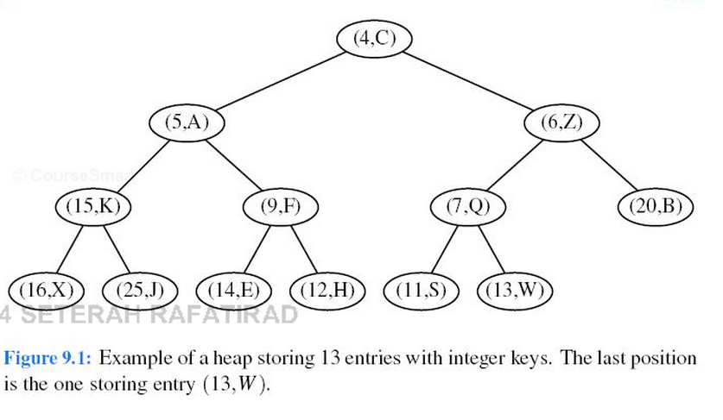
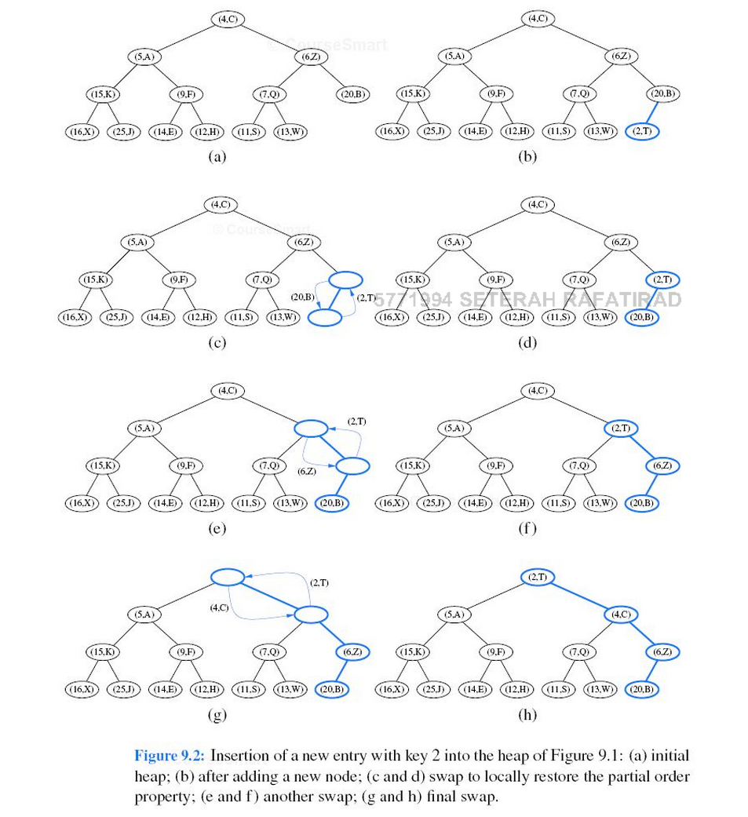
Implementing A PQ With A Heap Insert

Slide 18
Removal from a Heap
Method removeMin of the priority queue ADT corresponds to the removal of the root key from the heap.
The removal algorithm consists of three steps:
Replace the root key with the key of the last node w
Remove w
Restore the heap-order property (discussed next)
2
5
6
w
9
7
last node
7
5
w
6
9
new last node
© 2010 Goodrich, Tamassia
Notes:
The last node of a heap is the rightmost node of maximum depth.

Slide 19
Downheap
After replacing the root key with the key k of the last node, the heap-order property may be violated.
Algorithm downheap restores the heap-order property by swapping key k along a downward path from the root.
Upheap terminates when key k reaches a leaf or a node whose children have keys greater than or equal to k
Since a heap has height O(log n), downheap runs in O(log n) time
7
5
5
w
6
7
w
6
9
9
© 2010 Goodrich, Tamassia

Slide 20
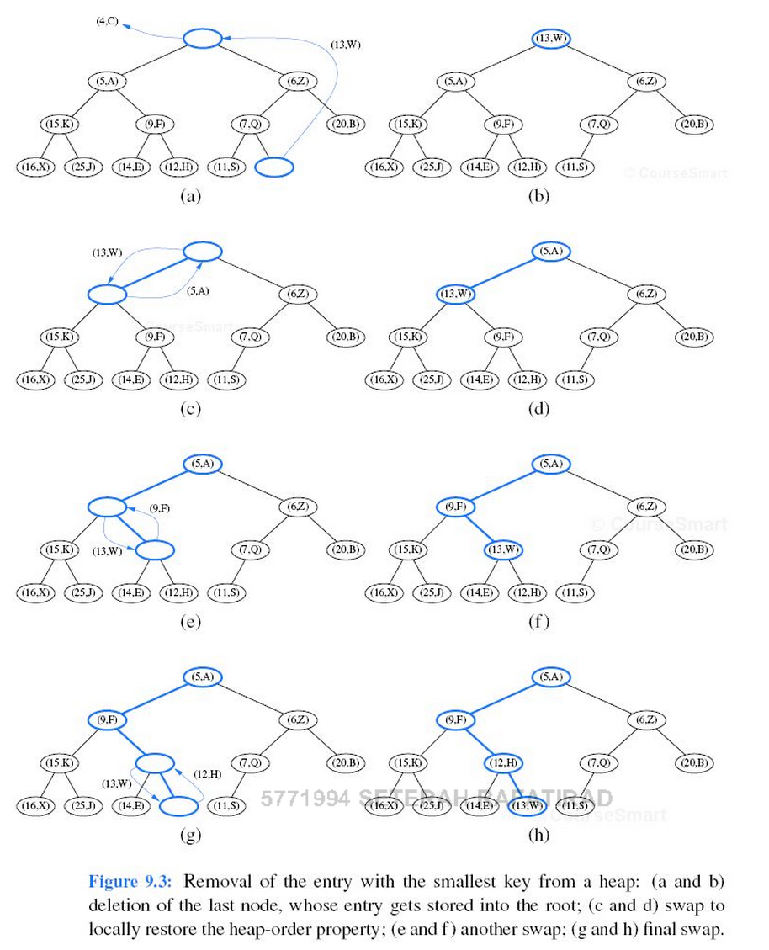
Implementing a PQ with a Heap Remove

Slide 21
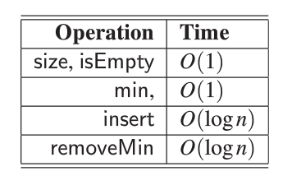
Analysis
© 2010 Goodrich, Tamassia

Slide 22
Heap-Sort
Consider a priority queue with n items implemented by means of a heap
the space used is O(n)
methods insert and removeMin take O(log n) time.
methods size, isEmpty, and min take time O(1) time
Using a heap-based priority queue, we can sort a sequence of n elements in O(n log n) time.
The resulting algorithm is called heap-sort
Heap-sort is much faster than quadratic sorting algorithms, such as insertion-sort and selection-sort.
© 2010 Goodrich, Tamassia

Slide 23
Exercise
How long would it take to remove the smallest elements from a heap that contains n entries using a priority queue model?

Slide 24
TreeSet
java.util.TreeSet;
TreeSet provides an implementation of the Set interface.
Objects are stored in sorted, ascending order.
Guarantees log(n) time cost for the basic operations (add, remove and contains).
Offers a few handy methods to deal with the ordered set like first(), last(), headSet(), and tailSet().
Self-Balancing feature.
TreeSet is basically implementation of a self-balancing binary search tree like Red-Black Tree. Therefore operations like add, remove and search take O(Log n) time. And operations like printing n elements in sorted order takes O(n) time.
Ordering: Red-Black Tree Algorithm (Add , then Balance)
Uses a red-black tree for storage.
Traversal: LrR (Left-Root-Right)
Notes:
The other concrete Set implementation is the TreeSet.
TreeSet provides an implementation of the Set interface that uses a tree for storage. Objects are stored in a sorted and ascending order.
A TreeSet keeps its elements ordered internally.
The tree is balanced, it's a red-black tree.
Elements added to the tree must be orderable.
Having a balanced tree guarantees a quick o(log n) search time at the cost of a more time-intensive insertion (and deletion).
Access and retrieval times are quite fast, which makes TreeSet an excellent choice when storing large amounts of sorted information that must be found quickly.
Unsynchronized means multiple concurrent threads can access the treeset and modify it, so synchronizing the access should be handled externally.

Slide 25
TreeSet Cont.
Adding elements
TreeSet does not preserve the insertion order of elements but elements are sorted by keys.
TreeSet does not allow to insert Heterogeneous objects. It will throw classCastException at Runtime if trying to add hetrogeneous objects.
Null insertion is not supported
If we insert null in a TreeSet, it throws NullPointerException because while inserting null it will get compared to existing elements and null can not be compared to any value.
Guarantees duplicate-free collection of elements.
Unsynchronized.
Documentation
https://docs.oracle.com/javase/7/docs/api/java/util/TreeSet.html

Slide 26
TreeSet Example
import java.util.*;
Public class TreeSetExample{
TreeSet<String> ts = new TreeSet<String>();
ts.add("C");
ts.add("A");
ts.add("B");
ts.add("E");
ts.add("F");
ts.add("D");
System.out.println(ts);
}
Self-balancing tree that keeps the tree balanced (with minimum height). Keeps the height small in the face of arbitrary number of insertions and deletions.
This means that the minimum height of a tree with n nodes is floor(log2 n).
Add method uses a comparator that sorts elements by default, or it can be arbitrary adjusted using a comparator .
In this case, elements are sorted by default in ascending order:
A, B, C, D, E, F

Slide 27
TreeSet Example
import java.util.*;
Public class TreeSetExample{
TreeSet<String> ts = new TreeSet<String>(new CompareTreeSet());
ts.add("C");
ts.add("A");
ts.add("A");
ts.add("B");
ts.add("F");
ts.add("E");
ts.add("F");
ts.add("D");
System.out.println(ts);
}
import java.util.Comparator;
public class CompareTreeSet implements Comparator<String>{
public int compare(String o1, String o2) {
if (o1.compareToIgnoreCase(o2)==0) return 0;
else if(o1.compareToIgnoreCase(o2) < 0)
return 1;
else return -1;
}
}
Add method uses a comparator that sorts elements in sorted in descending order:
F, E, D , C, B, A

Slide 28
TreeSet Constructors
TreeSet t = new TreeSet(); This will create empty TreeSet object in which elements will get stored in default natural sorting order.
TreeSet t = new TreeSet(Comparator comp); This constructor is used when you externally wants to specify sorting order of elements getting stored.
TreeSet t = new TreeSet(Collection col); This constructor is used when we want to convert any Collection object to TreeSet object.

Slide 29
https://docs.oracle.com/javase/7/docs/api/java/util/Collections.html

Slide 30
TreeSet t = new TreeSet(Collection col);
// Java program to demonstrate TreeSet creation from ArrayList
import java.util.*;
class TreeSetDemo{
public static void main (String[] args) {
ArrayList al = new ArrayList();
al.add("GeeksforGeeks");
al.add("GeeksQuiz");
al.add("Practice");
al.add("Compiler");
al.add("Compiler"); //will not be added
// Creating a TreeSet object from ArrayList
TreeSet ts4 = new TreeSet(al);
System.out.println(ts4);
}
}

Slide 31
TreeSet Synchronization
TreeSet ts = new TreeSet();
Set syncSet = Collections.synchronziedSet(ts);
Notes:
Implementation of TreeSet class is not synchronized. If there is need of synchronized version of TreeSet, it can be done externally using Collections.synchronizedSet() method.

Slide 32
import java.util.*;
public class TreeSetCollectionExample { public static void main(String[] args) {
//Creating a treeset as a Collection
Collection<String> treeCol = new TreeSet<String>(new CompareTreeSet());
treeCol.add("A"); treeCol.add("C"); treeCol.add("B");
treeCol.add("A"); treeCol.add("E"); treeCol.add("F");
//treeCol.add(null);
//verifying if the tree contains an element
if(treeCol.contains(new String("H"))) System.out.println("The tree contains H");
else System.out.println("The tree does not contain H");
…

Slide 33
…
//converting a collection to array
Object[] os = treeCol.toArray();
System.out.println("\nThe first element of the array representation of the treeset is: " +
(String) os[0]);
//printing elements using an iterator
System.out.println("\nPrinting the content of the treeset using an iterator:");
Iterator it = treeCol.iterator();
while(it.hasNext()) System.out.print(it.next()+" ");
System.out.println("\n\nPrinting the content of the treeset without iterator");
System.out.println(treeCol);
}
}

Slide 34
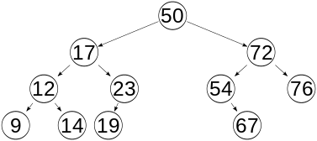
Height of a Balanced BST
1
height
1
1
Most operations on a binary search tree (BST) take time directly proportional to the height of the tree. So it is desirable to keep the height small.
To keep the height small, we need self-balancing that produces a balanced tree.

Slide 35
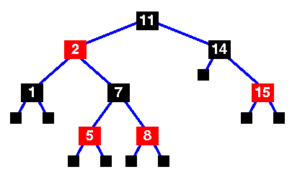
Red-Black Tree Rules
Every node in the tree is either black or red.
The root is always black.
If a node is red, its children must be black.
Every path from the root to a leaf (or null child) must contain the same number of black nodes. (Referenced from "Java Collections by John Zukowski Apress 2001")
Traversal (LrR): 1,2, 5,7,8,11,14,15
Notes:
3) implies that on any path from the root to a leaf, red nodes must not be adjacent. However, any number of black nodes may appear in a sequence.

Slide 36
Red-Black tree: Insert
i) First, insert elements similar to BST. Initially the color of the newly inserted node is red.
Notes:
Start with the root
Compare with the root, if it is smaller than root, process the left child, otherwise, process the right child.

Slide 37
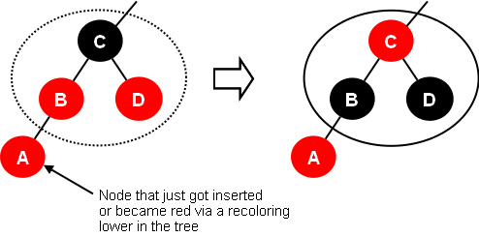
Red-Black tree: Insert
ii) Recoloring Rule
Recolor whenever the sibling of a red node's red parent (i.e., uncle) is red: recolor all other nodes in the subtree to apposite color (i.e., red to black, and black to red)
B: Red node’s (i.e., A) parent
D: sibling of B
Notes:
This recoloring is to avoid having two consecutive red nodes.
The extent of the subtree is determined by the grand-parent of the inserted node, excluding the newly inserted node.

Slide 38
Red-Black tree: Insert
iii) Restructuring Rule
Restructure whenever the red child's red parent's sibling is black or null. There are four cases:
Rotate Left/Right
When you restructure, the root of the restructured subtree is colored black and its children are colored red.

Slide 39
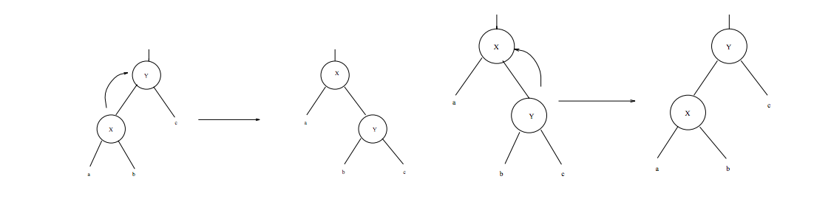
Left and Right Rotation
Right Rotation
Left Rotation

Slide 40
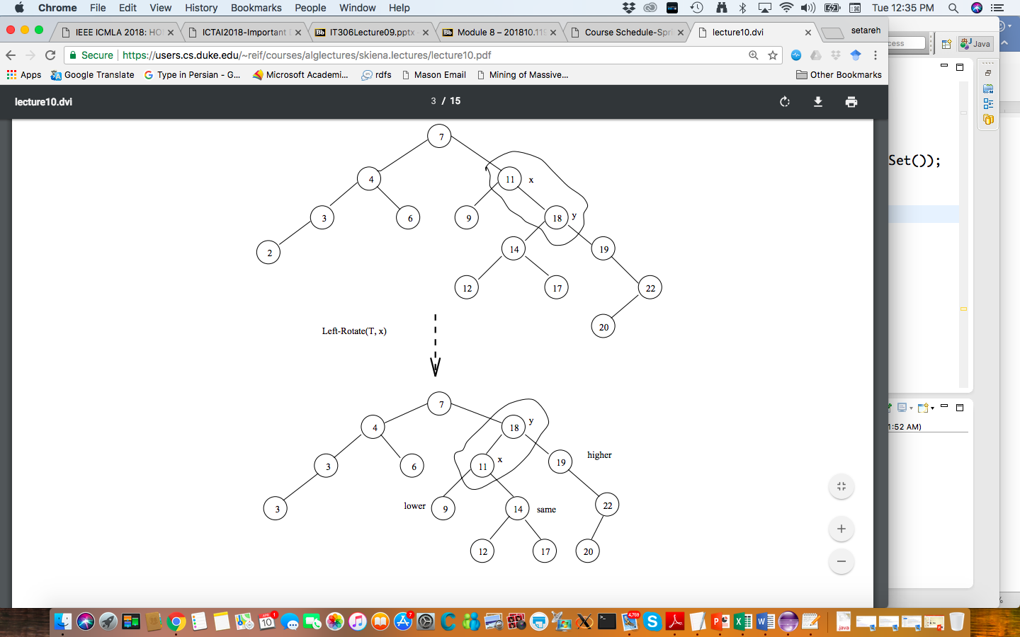
Left-Rotate Example
Notes:
In a rotation one subtree gets one level closer to the root and one subtree one level further from the root of the subtree.
In the left rotation, the children of the rotated node x remain its children. The node which is replaced by x should follow BST algorithm starting at the root which is the new parent of node x.

Slide 41
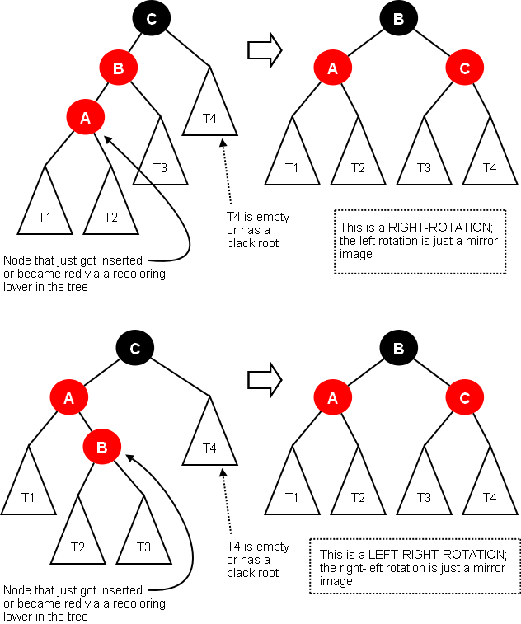
Restructuring Rule
Right Rotation:
One Right Rotation followed by
Recoloring
The left and right branches of the subtree plays an important role in the rotations.
Left-Right Rotation:
One Left Rotation followed by
one Right Rotation followed by
Recoloring
Notes:
iii) Restructuring Rule
Restructure whenever the red child's red parent's sibling is black or null. There are four cases:
Rotate Left/Right
When you restructure, the root of the restructured subtree is colored black and its children are colored red.

Slide 42
Example (Insert)
A
INSERT red new node ‘A’: ‘A’ is root
Root’s color is black.
A

Slide 43
Example (Insert)
A
2) INSERT ‘B’
3) INSERT ‘C’
B
A
Restructuring
B
B
Single left
A
C
New node’s uncle is null !
C
When you restructure (here, Left-Rotate), the root of the restructured subtree is colored black and its children are colored red.

Slide 44
Example (Insert)
4) INSERT ‘D’
B
D’s uncle is red (Recoloring)
A
C
D
B
recolor all other nodes in the subtree to apposite color (i.e., red to black, and black to red)
Root of the tree is always black.
A
C
D

Slide 45
Example (Insert)
5) INSERT ‘E’
B
A
C
E’s uncle is Null (restructuring-rotate single left)
subtree
D
E
B
A
D
When you restructure, the root of the restructured subtree is colored black and its children are colored red.
C
E
subtree
B
A
D
C
E

Slide 46
Example (Insert)
6) INSERT ‘F’
B
F’s uncle is red (recoloring)
A
D
C
E
F
B
recolor all other nodes in the subtree to apposite color (i.e., red to black, and black to red)
A
D
C
E
subtree
F
B
A
D
C
E
subtree
F

Slide 47
Example (Insert)
B
6) INSERT ‘H’
H’s uncle is Null (Restructuring- rotate left)
A
D
C
E
F
B
H
A
D
When you restructure, the root of the restructured subtree is colored black and its children are colored red.
C
F
B
A
D
subtree
E
H
C
F
subtree
E
H

Slide 48
Example (Insert)
B
7) INSERT ‘G’
A
D
G’s uncle is red (recoloring)
C
F
E
H
B
A
D
G
recolor all other nodes in the subtree to apposite color (i.e., red to black, and black to red)
C
F
B
H
E
D
subtree
A
G
C
F
F’s uncle is black (restructuring , rotate left)
E
H
subtree
G

Slide 49
Example (Insert)
Two consecutive red nodes.
B
F’s uncle is black (restructuring , Left-Right Rotation)
7) INSERT ‘G’ cont.
A
D
C
F
E
H
B
Rotate Left
A
F
G
E
H
Recoloring
Rotate Right
(imbalanced )
B
D
G
B
A
F
C
A
F
D
H
D
H
C
E
G
C
E
G

Slide 50
Exercise
Insert the following characters into a TreeSet using the red-black algorithm. Show the steps.
Q,A,D,E,L,K,J,H,Y

